Slide 1
PA Compression Test Software Improvements for M/A-COM
Nick Lalic
VNA Software Developer
August 17th, 2015

Slide 2
PA Compression Test
M/A-COM Requested improvements:
Plot Phase vs Pin, Pout
Reference compression to gain expansion (max. gain)
Continuously update results during measurement
Stop power at compression (overdrive protection)
Accommodate pulsed power

Slide 3
PA Compression Test Software Current capability

Slide 4
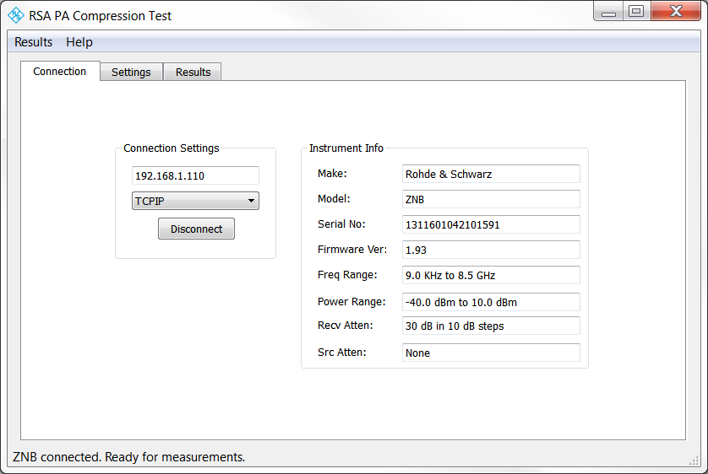
PA Compression Test
Current version of the software:
Run on/off instrument
Connect via VISA (Ethernet, GPIB)

Slide 5
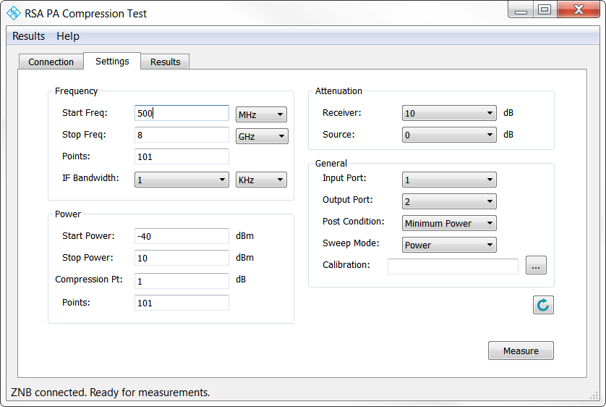
PA Compression Test
Current version of the software:
Measurement settings

Slide 6
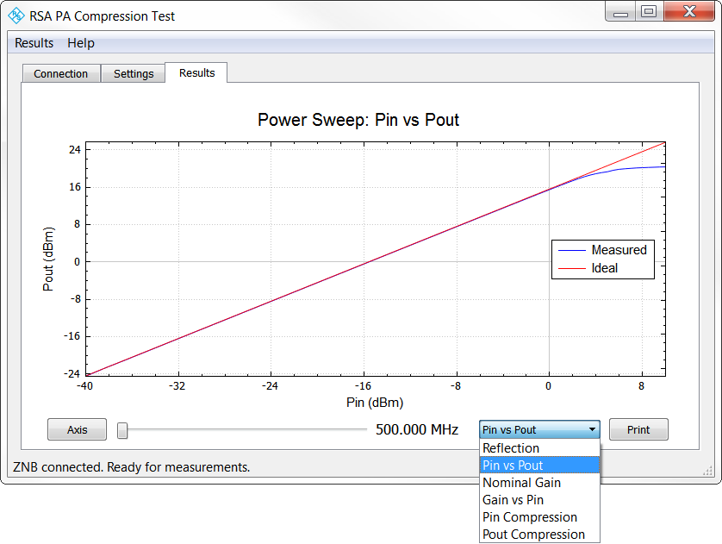
PA Compression Test
Current version of the software:
Generate common plots
Print to PDF

Slide 7
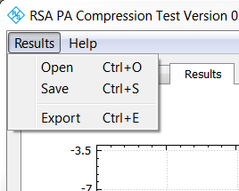
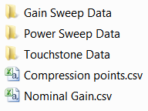
PA Compression Test
Current version of the software:
Open/Save
Reload results into application to generate plots later
Export data
CSV, Touchstone files of data

Slide 8
PA Compression Test Software Improvements

Slide 9
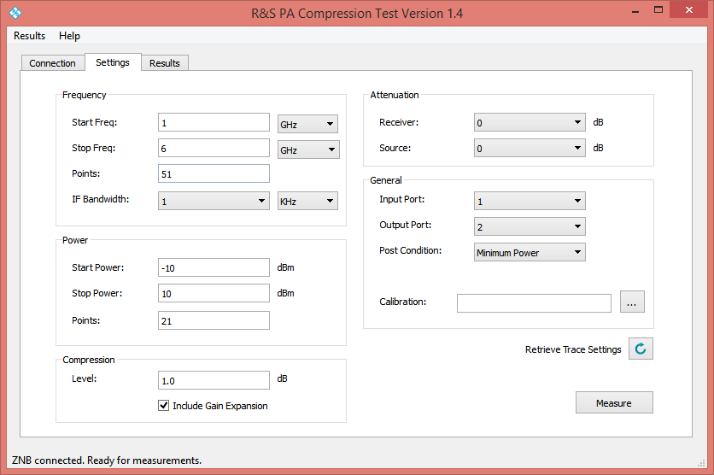
PA Compression Test
In progress:
Calculate compression from Maximum Gain (Gain expansion)

Slide 10
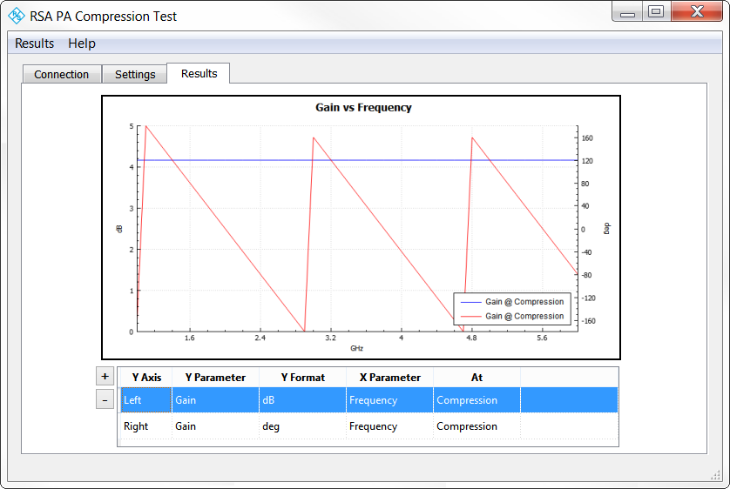
PA Compression Test
In progress:
Customize traces, axes in plots

Slide 11
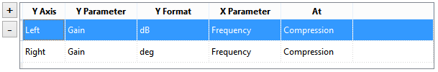
PA Compression Test
In progress:
Customize traces, axes in plots
Add/Remove traces
Left/Right Y-Axis
Y Parameters:
Input Reflection, Gain, Reverse Gain, Output Reflection, Pin, Pout
Y Formats:
dB, mag, deg, rad, VSWR, dBm
X Parameter:
Frequency, Pin
At:
Fixed (custom) Pin value
Fixed (custom) Frequency
Compression
Maximum Gain

Slide 12
PA Compression Test
In progress:
Continuous compression data update
Display results as sweeps are completed
Stop at compression point (overdrive protection)
If compression is reached before Stop Power, stop the sweep
Still researching best (fastest) way to implement this
Accommodate pulsed RF measurements
User configures VNA for pulsed RF measurement
Application detects pulsed RF conditions
Measurement sweeps use current triggers, timing

Slide 13
PA Compression Test
Timeline:
Free select plots – This week (8/21)
Gain expansion – This week (8/21)
Continuously update results – Next week (8/28)
Overdrive protection – One month
Pulsed RF – 1-2 months

